Slide 1


Department of Computer Science and Engineering
IT23A11 –IOT
IOT BASED REAL-TIME MONITORING FOR SECURE OPERATIONS OF ELECTRIC VEHICLES
ANU S -230701030 ASHNA V-230701042

Slide 2
ABSTRACT
Electric Vehicles (EVs) offer numerous advantages over conventional petrol and diesel vehicles, including lower running and maintenance costs, reduced environmental impact with the use of renewable energy, eco-friendly materials, decreased pollution, energy independence, and quieter operation. To encourage the adoption of EVs, state and central governments are providing subsidies and incentives, and it is expected that EVs will become increasingly common on the roads in the coming years. However, safety concerns such as battery fires due to excessive heat during charging and discharging, and short circuits caused by floodwater contact with live conductors, have emerged. These risks, along with threats like theft, can be mitigated through IoT-based monitoring, alert, and control systems. Such systems can track parameters like battery temperature, vehicle speed, location, and flood water levels, transmitting this data via cloud platforms to the EV owner's mobile device and monitoring systems, thus helping to prevent hazardous incidents. A prototype IoT model has been developed for real-time monitoring, alerting, and controlling of EVs, and its performance has been studied.

Slide 3
Introduction
With the growing reliance on electric vehicles (EVs) for sustainable transportation, ensuring their secure and efficient operation has become crucial. Our project, "IoT-Based Real-Time Monitoring for a Secure Operation in Electric Vehicles," proposes an intelligent system that uses Internet of Things (IoT) technology to monitor critical vehicle parameters in real time. The system is equipped with embedded sensors that continuously track battery and motor temperature to prevent overheating, detect flood water levels around the vehicle for early warning and protection, and monitor speed to ensure the vehicle operates within safe and efficient limits. These real-time insights not only help in preventing potential hazards but also enable proactive maintenance and data-driven performance optimization. By integrating these monitoring capabilities into EVs, the project aims to improve overall safety, extend vehicle lifespan, and support smarter transportation infrastructure for both end-users and manufacturers.

Slide 4
Problem Statement
While electric vehicles are gaining popularity as a clean alternative to conventional transportation, concerns regarding their operational safety, energy efficiency, and lack of real-time monitoring persist. The absence of a reliable system to continuously track vehicle performance, detect anomalies, and ensure operational security limits the widespread adoption of EVs. There is a critical need for a smart, connected solution that can monitor EV operations in real-time and provide actionable insights for secure and efficient performance

Slide 5
Proposed Work
All the sensor data is processed by the central microcontroller and displayed in real-time on an screen for local monitoring. Simultaneously, the data is sent to the cloud or a mobile/web application using a Wi-Fi module (NodeMCU/ESP8266) for remote tracking and alert generation. In the event of critical values being detected—such as high temperature, excess water level, or overspeed—alerts are generated to notify the driver or control system.
The system is powered using a regulated power supply unit (transformer and rectifier), ensuring stable operation of all components. This prototype demonstrates how embedded systems and IoT can work together to provide early warnings, fault detection, and preventive actions, making EVs more secure and intelligent.

Slide 6
Implementation
Power Supply and Microcontroller Setup A step-down transformer with a rectifier circuit provides a stable DC supply to the system.
A microcontroller board is used to control the entire system by collecting sensor data, processing it, and managing output actions like displaying information on the LCD.
Sensor Connections
A temperature sensor monitors motor/battery heat levels.
A water level sensor detects flood conditions near the EV.
An IR sensor measures wheel rotations to calculate vehicle speed. All sensors are interfaced with the microcontroller for continuous real-time monitoring.
Display and Alert System A displays live data such as temperature, speed, and water level. If any readings exceed safe limits, immediate visual alerts are provided to the driver through the display.
IoT Integration for Remote Monitoring A NodeMCU (ESP8266) Wi-Fi module sends real-time sensor data to a cloud platform or mobile app, allowing remote tracking and instant notifications during critical events to improve EV safety and reliability.

Slide 7
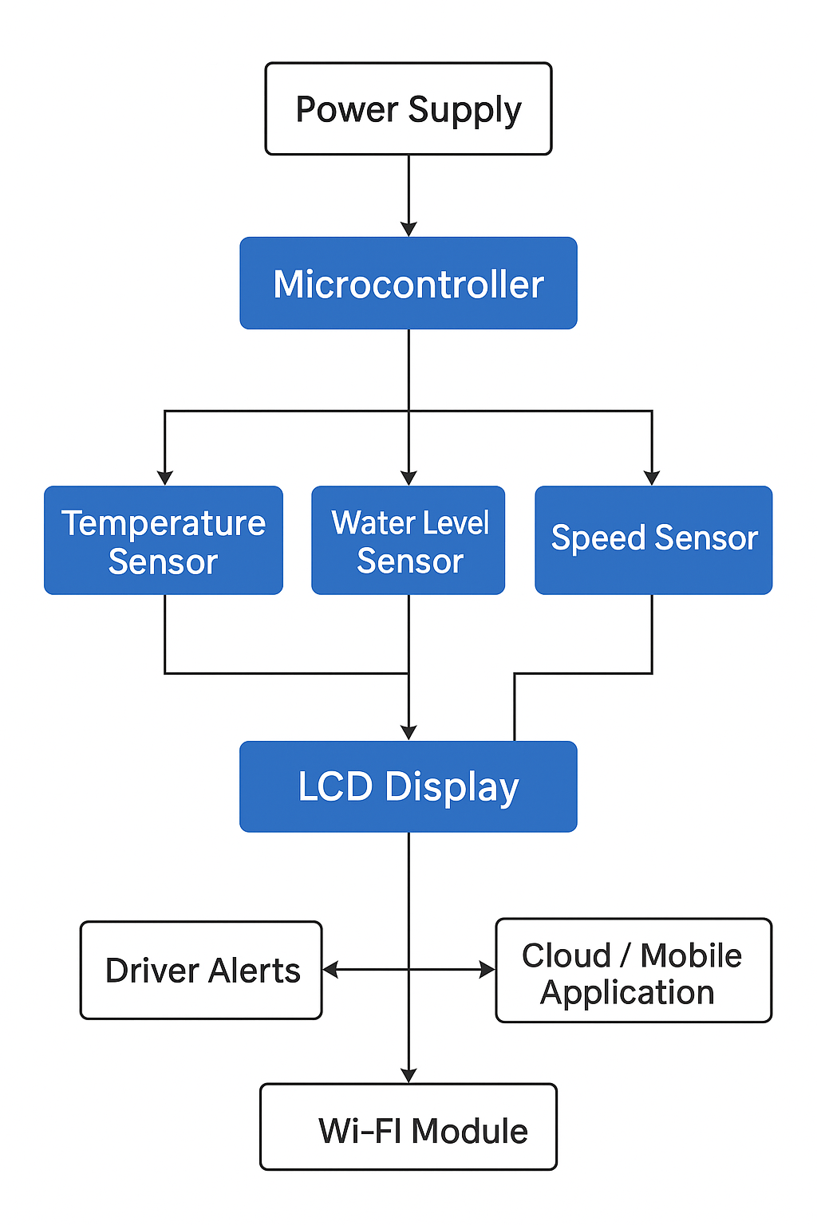
Architecture

Slide 8
System requirements
ESP8266-12E NodeMCU with Wi-Fi Module
L298N Motor Driver Module
Temperature Sensor (DHT11)
Current Sensor Module (ACS712)

Slide 9
Advantages of the proposed system
Safety Alerts – Detects battery overheating, short circuits, and flood risks in real-time.
Smart Maintenance – Predicts faults early to reduce breakdowns and costs.
Energy Efficiency – Optimizes battery use and charging patterns.
User Convenience – Allows remote monitoring via mobile apps and real-time updates.

Slide 10
Implementation of EV Monitoring System
The system is installed inside the electric vehicle and consists of multiple sensors that help monitor the vehicle's safety in real time. Each sensor plays a specific role:
The temperature sensor is attached near the battery or motor. It continuously checks if the components are getting too hot.
The water level sensor is placed underneath the vehicle to detect rising water levels during floods or in water-logged areas.
The IR speed sensor keeps track of how fast the vehicle is moving by counting wheel rotations.

Slide 11
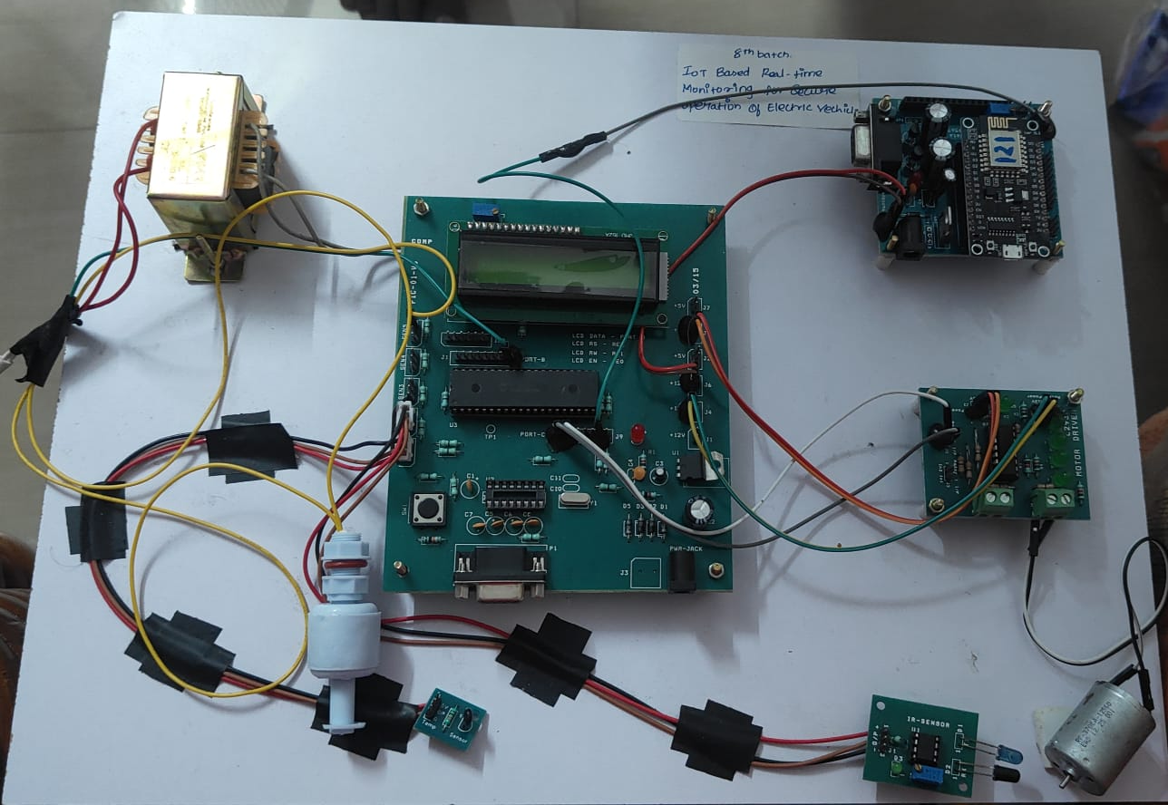
Prototype

Slide 12
Implementation of EV Monitoring System
All the data from these sensors is sent to a microcontroller (like Arduino or NodeMCU), which acts like the brain of the system. This microcontroller reads the values and checks if anything crosses a safe limit (like high temperature or high water level).
If something dangerous is detected, the microcontroller immediately:
Displays a warning on the LCD screen inside the vehicle.
Sends the alert wirelessly to a smartphone app or cloud system using a Wi-Fi (NodeMCU/ESP8266) module.
This real-time monitoring helps the driver stay informed and react quickly, improving the safety, reliability, and performance of the EV.

Slide 13
Conclusion
This project successfully demonstrates the design and implementation of an IoT-based real-time monitoring system for electric vehicles. By integrating key sensors and a Wi-Fi-enabled microcontroller, the system efficiently monitors vital EV parameters such as battery voltage, motor temperature, and current flow. It ensures safe and secure operation through timely alerts and real-time data visualization. The prototype highlights the potential of IoT in enhancing the reliability, safety, and performance of electric vehicles. This solution not only supports preventive maintenance but also contributes to a smarter, more sustainable transportation system.

Slide 14
References
[1] Alzahrani A., Shamsi P. and Ferdowsi M., "Single and interleaved split-pi DC-DC converter," 2017 IEEE 6th International Conference on Renewable Energy Research and Applications (ICRERA), San Diego, CA, USA, 2017, pp. 995-1000, doi: 10.1109/ICRERA.2017.8191207.
[2] Caricchi F., CrescimbiniF.andDi Napoli A., "20 kW water-cooled prototype of a buck-boost bidirectional DC-DC converter topology for electrical vehicle motor drives," Proceedings of 1995 IEEE Applied Power Electronics Conference and Exposition APEC'95, Dallas, TX, USA, 1995, pp. 887-892 vol.2, doi: 10.1109/APEC.1995.469045.

Slide 15
Thank You

